Slide 1
Business analytical project Report
Name
Institution

Slide 2
Introduction
This project presents an understanding of different statistical analyses on DC home price data.
The report includes three different statistical tests, which include confidence interval, analysis of variance, and regression.
Each of the tests focuses on different research questions and hypotheses, which have been clearly outlined in each section. Effective assessment of these elements present a unique integration of better aspects that help diversify organizational performance.

Slide 3
Confidence intervals –Research question
The analysis in this case provide focus on the confidence interval between the two independent groups
Question 1
Is there significant difference in SQFT Finished basement and SQFT unfinished basement?
Question 2
Is there significant difference in SQFT Home and Total SQFT?

Slide 4
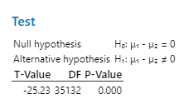
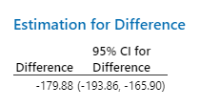
Confidence intervals
Question 1
Ho: There is no statistically significant difference SQFT Finished basement and SQFT unfinished basement.
Ha: There is statistically significant difference SQFT Finished basement and SQFT unfinished basement.
The analysis shows that the confidence interval does not contain the null hypothesis value hence we reject the null hypothesis and conclude that there is statistically significant difference between SQFT Finished basement and SQFT unfinished basement, 95% CI {-198.86, -165.90}

Slide 5
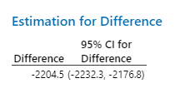

Confidence intervals
Question 2
Ho: There is no significant difference in SQFT Home and Total SQFT
Ha: There is significant difference in SQFT Home and Total SQFT
The analysis shows that the confidence interval does not contain the null hypothesis value hence we reject the null hypothesis and conclude that there is statistically significant difference SQFT Home and Total SQFT, 95% CI {-2232.3, -2176.8}

Slide 6
Analysis of variance
Analysis of variance present a specific approach where it is possible to determine the existing significant difference between the mean of two or more independent groups based on a continuous variable.
Question 1
Is there difference in sales based on build quality
Question 2
Is there difference in age at sale and build quality

Slide 7
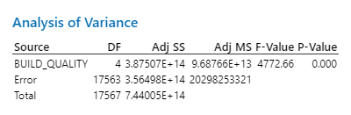
Analysis of variance
Question 1
Ho: There is no statistically significant difference in sales based on build quality.
Ha: There is statistically significant difference in sales based on build quality.
The one way analysis of variance shows that at F(4, 17563) = 4772.66, p<0.05. Thus we reject the null hypothesis and conclude that there is statistically significant difference in sales based on build quality.
Thus, there is need to conduct post hoc analysis to determine which groups are different

Slide 8
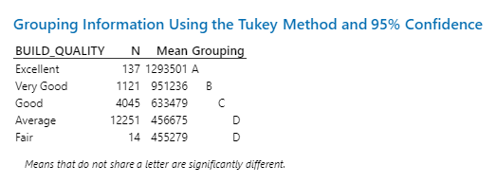
Analysis of variance
Post hoc analysis
The pairwise tukey post hoc analysis shows that only average and fair groups are not statistically significant different since they share a letter.
Excellent, very good and good are statistically different groups based on post hoc analysis

Slide 9
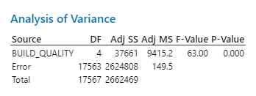
Analysis of variance
Question 2
Ho: There is no statistically significant difference in age at sale based on build quality .
Ha: There is statistically significant difference in age at sale based on build quality
The one way analysis of variance shows that at F(4, 17563) = 63, p<0.05. Thus we reject the null hypothesis and conclude that there is statistically significant difference in age at sale based on build quality.
Thus, there is need to conduct post hoc analysis to determine which groups are different

Slide 10
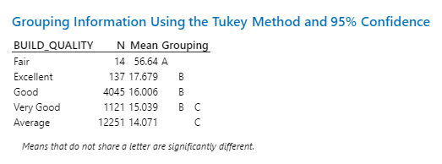
Analysis of variance
Post hoc analysis
Tukey pairwise post hoc analysis was performed where there is was no significant difference in Excellent, Good and very good. The results also showed that there was no significant difference between very good and average.
The group, fair was statistically different from all the other groups included in the analysis assessing build quality based on age at sale.

Slide 11
Regression analysis
Regression analysis present a strong emphasis on the underlying variables based on assessment of the existing dependent and independent variables.
Question 1:
Does the number of fireplaces predict sale price ?
Question 2
Does age at sale, remodeled and number of bathrooms predict sale price?

Slide 12
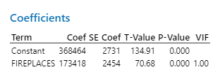

Regression analysis
Question 1
Ho: The number of fireplaces does not predict sale price.
Ha: The number of fireplaces does predict sale predict.
The analysis of linear regression analysis showed that fireplaces was a significant predictor of sale price , p<0.05.
The model summary shows that 22.14% of sale price is explained by fireplaces.
Regression Equation
Sale price (y)=368464 + 173418 Fireplaces

Slide 13
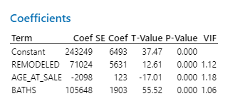
Regression analysis
Question 2
Ho: Age at sale, remodeled and number of bathrooms do not predict sale price.
Ha: Age at sale, remodeled and number of bathrooms do not predict sale price.
The multiple linear regression shows that age at sale, remodeled and baths , p<0.05, are statistically significant predictors of sale price.
These variables predict 18.67% of the sale price.
The regression equation is
(0) Sale (y)=243249 - 2098 age at sale + 105648 baths + 71024 remodelled

Slide 14
Discussion
The analysis has provided an understanding of three different statistical tests that have provided a crucial knowledge on various concepts based on DC home Price data.
The confidence interval analysis determined that there was a significant mean different difference between SQFT Finished basement and SQFT unfinished basement. This means that SQFT with finished basement attracts a higher price which is a major factor in improving efficiency and maximize the selling price by ensuring that there is better integration of important factors that help diversify outcomes.

Slide 15
Discussion
Analysis of variance sought to determine whether there is difference between build quality groups.
The findings obtained different results based on the continuous dependent that was included. Post hoc analysis was important in helping improve the outcomes.
There are different factors that influence sale price to a varying degree.
Fireplaces, baths age at sale, and whether the house was remodeled provide a key emphasis on better processes that help improve the overall performance.

Slide 16
Discussion
Therefore in order to improve the sale price, it is important to increase efficiency and maximize profits.
The different factors that have been included have provided a strong assessment oF specific factors that help modify organizational performance.
The limitation of the study is that there is no understanding on how the data was collected hence difficult to prove that the data is not biased.

Slide 17
References
Greenland, S., Senn, S. J., Rothman, K. J., Carlin, J. B., Poole, C., Goodman, S. N., & Altman, D. G. (2016). Statistical tests, P values, confidence intervals, and power: a guide to misinterpretations. European journal of epidemiology, 31(4), 337-350.
Kim, H. J., Luo, J., Chen, H. S., Green, D., Buckman, D., Byrne, J., & Feuer, E. J. (2017). Improved confidence interval for average annual percent change in trend analysis. Statistics in medicine, 36(19), 3059-3074.
Kamper, S. J. (2019). Showing confidence (intervals). Brazilian journal of physical therapy, 23(4), 277.

